Slide 1
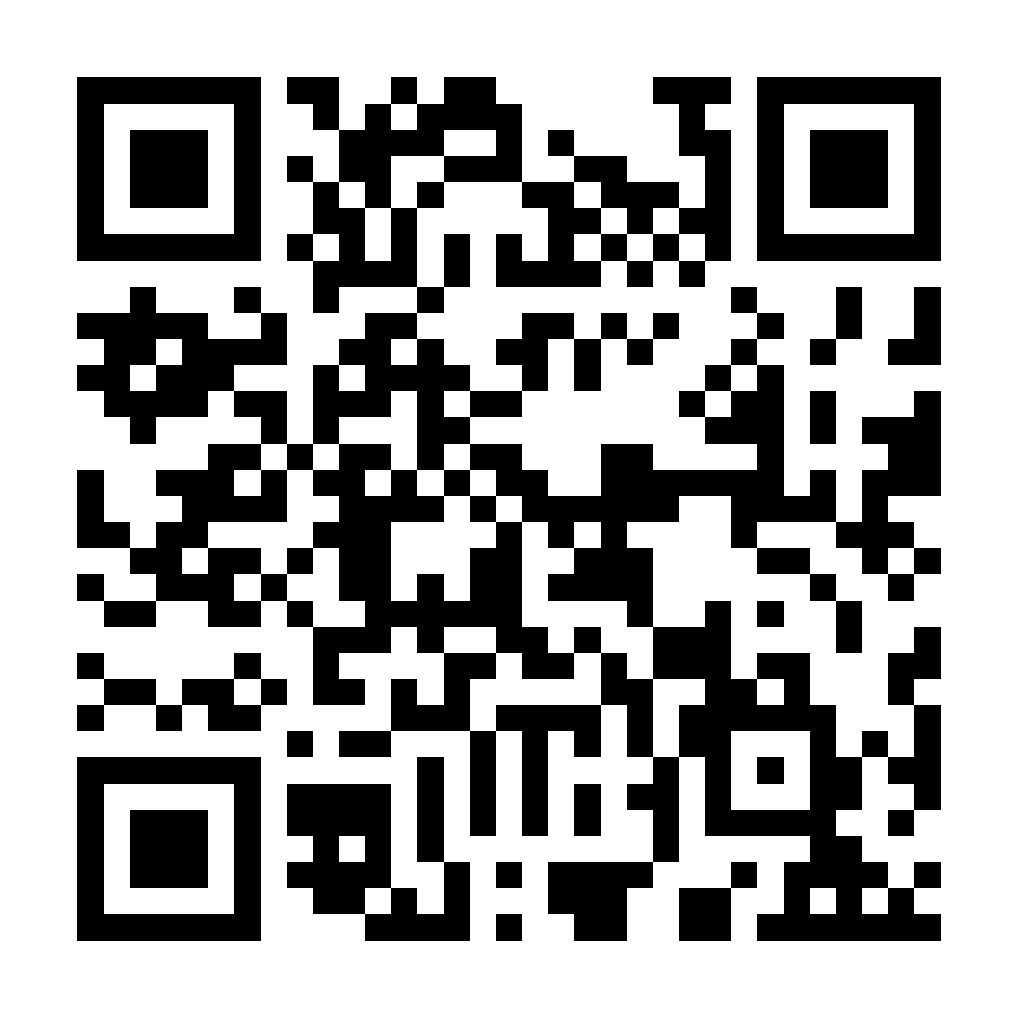
GAZA CRISIS APPEAL
A ceasefire means more aid can assist people affected in Gaza. Your support is urgently needed.
www.caritas.org.au/gaza
1800 024 413
DONATE NOW
Photo: Caritas Jerusalem

